Slide 1
Project 3 – Group 1 Fake news Classifier
Alejandro Zahinos
Sofia Steph
Tejal Bhatti
Karel de Rijk

Slide 2
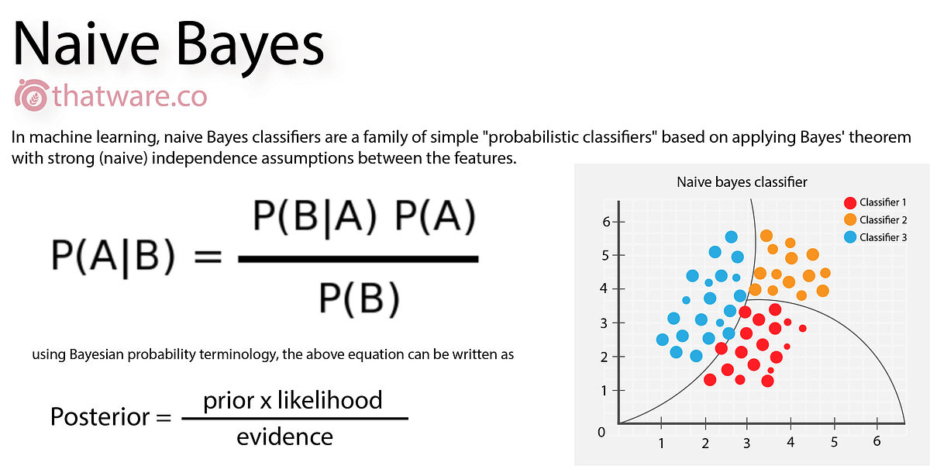

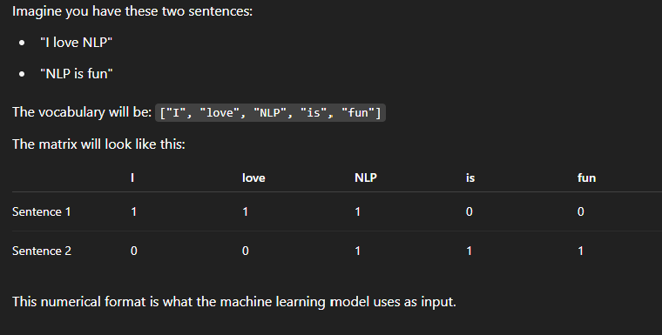
Executive summary
Final Model
Naïve Bayes with Count Vectorizer
Final Results
Training accuracy: 0.95
Validation accuracy: 0.93%
Alternatives considered
Feature extraction: TFIDF
Models: Logistic Regression, XGBoost, RandomForest

Slide 3
Methods used – Preprocessing
🔍 1. Text Cleaning
🌱 4. Lemmatization
Converted all text to lowercase.
Removed URLs, punctuation, numbers, and special characters using regular expressions.
Reduced words to their base or dictionary form (e.g., “running” → “run”).
📊 5. Vectorization
🧹 2. Tokenization
Transformed cleaned text into numerical vectors using:
CountVectorizer (Bag of Words)
TF-IDF Vectorizer (Term Frequency-Inverse Document Frequency)
Split sentences into individual words.
🧼 3. Stopword Removal
Removed common English words that do not add meaning (e.g., “the”, “and”, “is”).

Slide 4
Model Summary
Feature Extraction | Model | Accuracy |  | F1 Score
 |  | Training | Testing | Testing
Count Vectorizer | Naive Bayes | 0.95 | 0.94 | 0.93
 | Logistic Regression | 0.97 | 0.93 | 0.93
 | XGBoost | 0.89 | 0.88 | 0.88
TF-IDF | Logistic Regression | 0.95 | 0.93 | 0.92
 | XGBoost | 0.91 | 0.88 | 0.88
 | Random Forest | 0.99 | 0.91 | 0.91

Slide 5
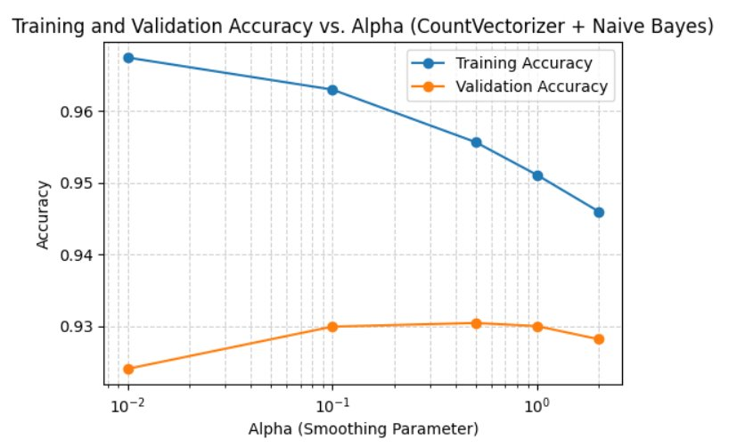
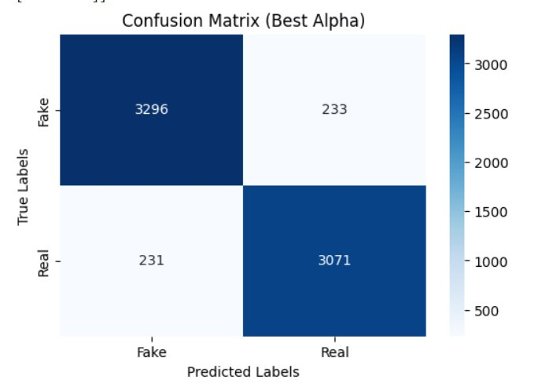
Results

Slide 6
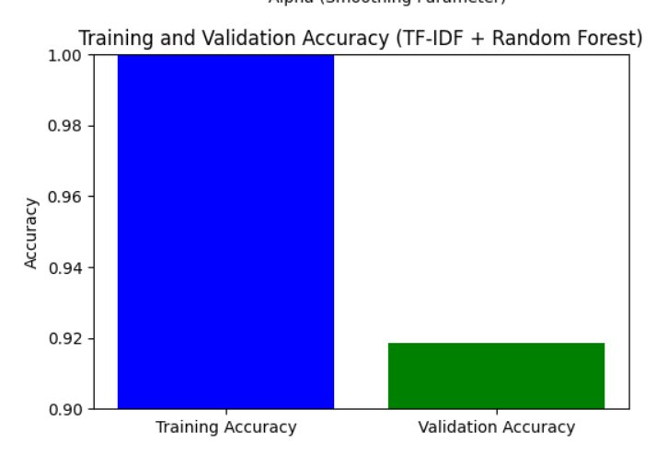
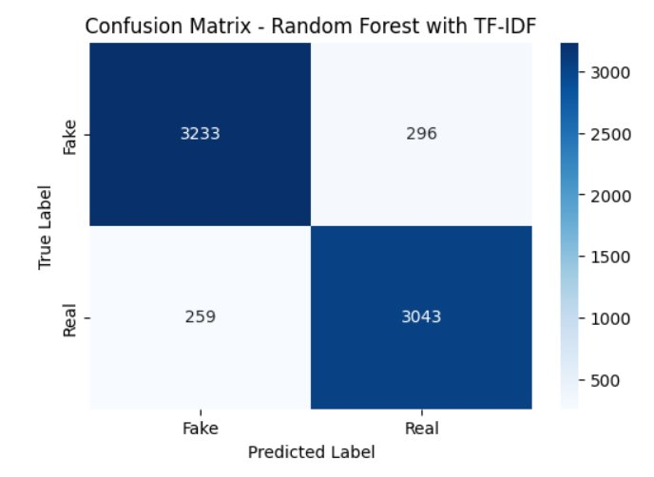
Results

Slide 7
Embedding
[1] Raw Text Data
[2] Tokenization - Using DistilBERT Tokenizer - Converts text into input tokens with special tokens like [CLS], [SEP]
[3] Embedding Generation - Tokens are passed to DistilBERT model - Output: contextual embeddings for each token
[4] Feature Vector Creation
[5] Logistic Regression - Trains a simple classifier
[6] Prediction - Output: 0 (Fake) or 1 (Real)

Slide 8
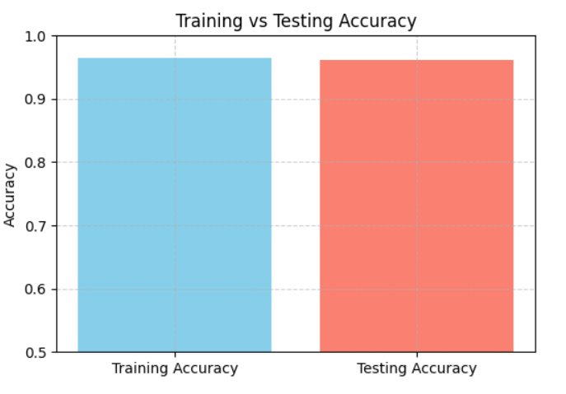
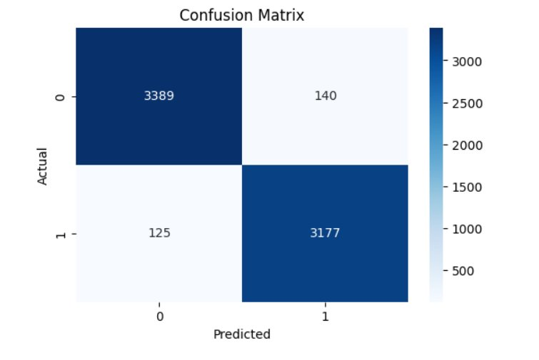
Results --Embedding

Slide 9

Summary
Pre-processed data:
Text cleaning, Tokenization, Stop-word removal, Lemmatization, Vectorization
Winning Strategy
The Count Vectorizer combined with Naive Bayes model
Key learnings: Most complicated model does not give the best results necessarily. It’s dependent on the dataset.
And the patterns that characterize fake news are not very subtle.
Straight forward model is better for a simple data set with straight forward patterns.
Alternative Strategies Implemented
TFIDF, Vectorizer logistic regression, XGBoost, and Random Forrest.

Slide 10
Challenges
Random Forrest Overfitting
Data Cleaning challenge
Cause:
TFIDF Vectorizers works well on high dimensional data, but our use case was with a simple dataset.
Cause: Acronyms with use of periods (i.e. U.S.A) suffered from over cleaning so part of the acrynym was removed U.S. -> U.
Solutions:
Do a grid search and find the best param for Random Forrest
Additional Challenge:
Grid search requires a lot of GPU and takes a very long time to process, so it is not time efficient.
Solution:
Finding another method to clean data that preserved acronyms.
Additional Challenge: This was not possible.
Final Solution:
Model will interpret the data the same was anyway based on the frequency of the fragment.

Slide 11

Thank you for your attention!

